Slide 1
CST-411
Analysis and visualization

Slide 2

License and References
This work is licensed under a Creative Commons Attribution-NonCommercial-ShareAlike 4.0 International License
Fore more details: https://creativecommons.org/licenses/by-nc-sa/4.0/
The author is indebted to the generosity of others who have provided example problems and datasets. Where appropriate, external sources are cited both in the slides and in Jupyter Notebooks
Images from around the Web are also used to help convey concepts
Content that is reused in these slides is either open licensed or, as I understand it, meets the Fair Use Doctrine for educational reuse.

Slide 3
License and References
My university offering of this course has an introductory Python course as a prerequisite
That course uses
Python Programming: An Introduction to Computer Science 2010, 3rd Edition, John Zelle, Franklin, Beedle & Associates Inc., ISBN 9781590282755
At times, example problems from that text will be cited

Slide 4
Mystery dataset
There is data available at: http://narock.github.io/teaching/CST-411/sample.tsv
It is a Tab Separated Variable file
Try reading it into a notebook and exploring the data
These data are related to something that’s in the news this week (September 12, 2018)

Slide 5
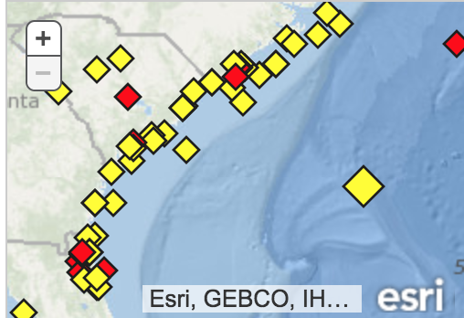
Hurricane florence
These data come from the National Oceanographic and Atmospheric Adminstration’s buoy program
These particular data are from buoy 41002 positioned 225 nautical miles south of Cape Hatteras, North Carolina
https://www.ndbc.noaa.gov/station_page.php?station=41002
These are the same buoys used
in the weather forecasting this week
Image Credit: NOAA
Our bouy

Slide 6

Hurricane Florence as seen from the International Space Station, Credit: NASA

Slide 7

Hurricane Florence as seen from the International Space Station, Credit: NASA

Slide 8
Tell a story with data
There are 4 dataset descriptions available. Use what you’ve learned about scientific computing to tell a story with the data.
Specifically,
Read the data into a Jupyter Notebook
Explore the data. How many rows/columns? Anything look out of place?
Analyze and visualize the data – what is it telling you?
Use your notebook to explain your data, analysis, and conclusions to your classmates

